Slide 1

Multiple Linear Regression

Slide 2

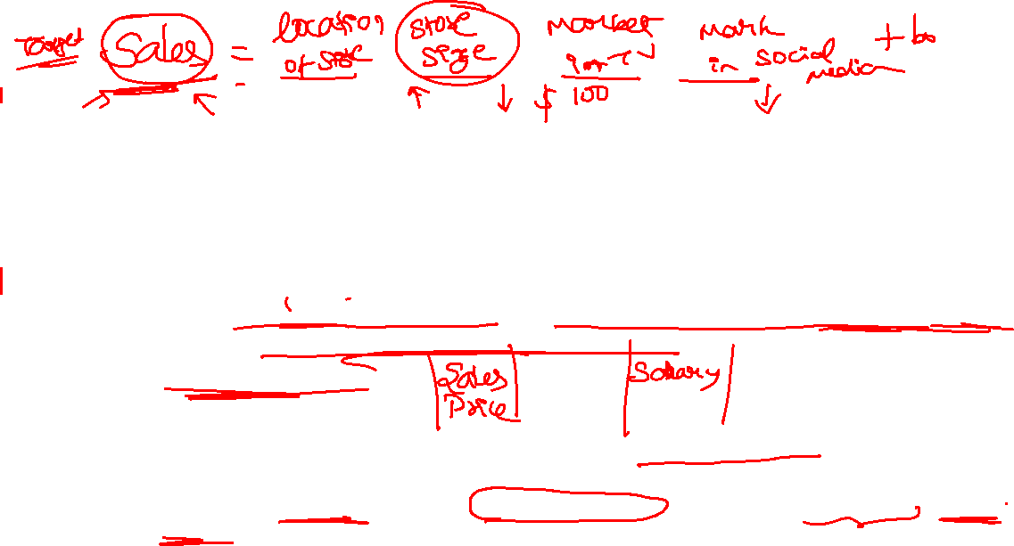
Overview of Regression Analysis
What is Regression Analysis?
Regression analysis is a statistical method used to model and analyze the relationship between a dependent (target) variable and one or more independent (predictor) variables.
It helps in predicting the value of the dependent variable based on the values of the independent variables.
Simple Linear Regression: Uses a single predictor variable to predict the dependent variable.
Multiple Linear Regression (MLR): Involves multiple predictor variables, which is useful for more complex and accurate predictions.

Slide 3
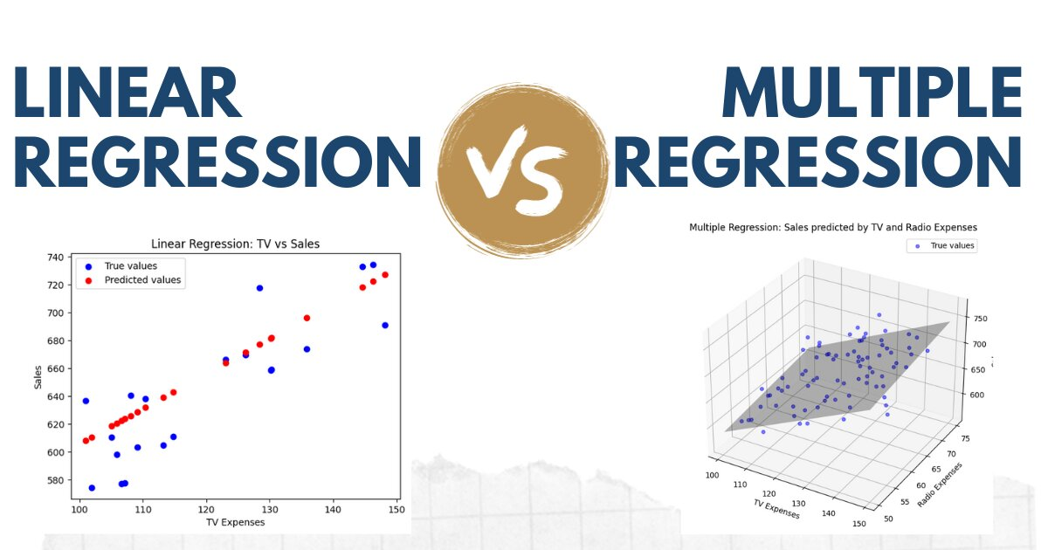

Purpose of Multiple Linear Regression
To understand how multiple factors (independent variables) influence an outcome (dependent variable).
To predict the value of a dependent variable based on multiple inputs.

Slide 4


What is Multiple Linear Regression?
Multiple Linear Regression (MLR) is a statistical technique that models the relationship between a dependent variable and two or more independent variables by fitting a linear equation to observed data.
Y: Dependent variable (the outcome we want to predict)
X1,X2,…,XnX_1, X_2, \dots, X_nX1​,X2​,…,Xn​: Independent variables (factors that influence the outcome)
β0​: Intercept (the expected value of Y when all X s are 0)
β1,β2,…,βn​: Coefficients (representing the effect each X has on Y)
ϵ: Error term (the residual or deviation of the actual value from the predicted value)

Slide 5
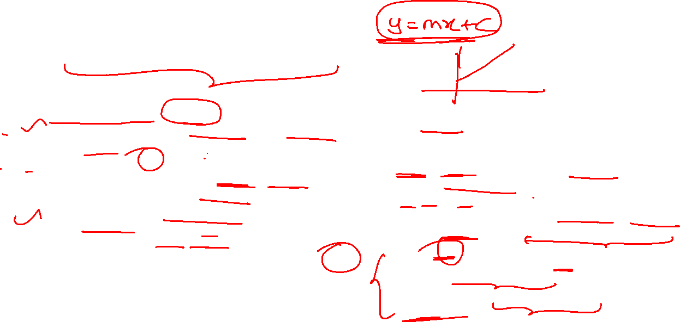
Key Terms & Notation
Coefficients (β)
Each predictor X has an associated coefficient, which quantifies its effect on Y.
β0​: Intercept (baseline value of Y when all predictors are zero).
β1,β2,…,βn​: Coefficients for each independent variable, indicating the change in Y for a one-unit change in X, holding other predictors constant.
Error Term (ϵ)
Represents the variation in Y that cannot be explained by the predictors.
Assumed to be normally distributed with a mean of zero.
Dependent Variable (Target)
Also called the outcome variable or response variable.
Denoted by Y in the equation.
The variable we aim to predict or explain.
Independent Variables (Predictors)
Also called explanatory variables, features, or covariates.
Denoted by X1,X2,…,Xn.
Variables that are used to predict the value of Y.

Slide 6
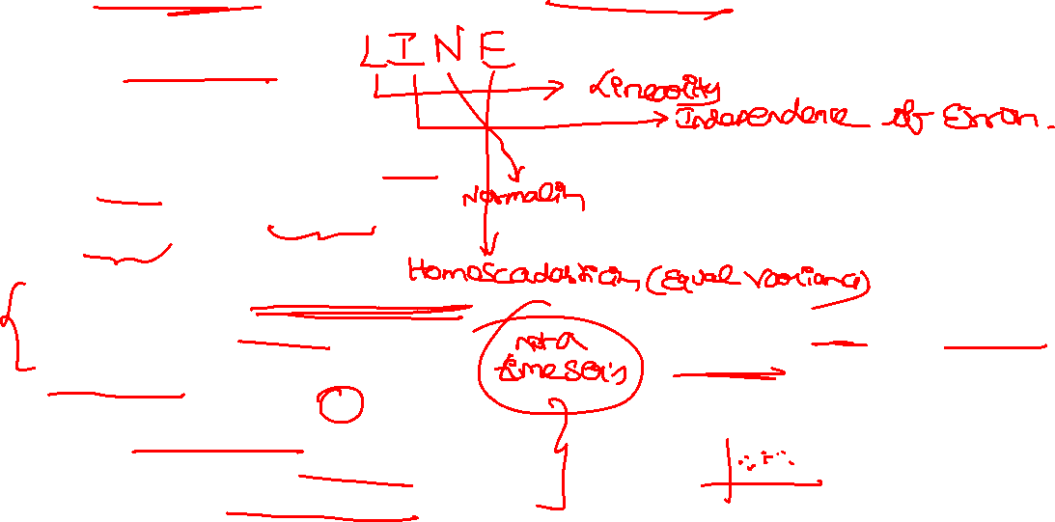
Key Assumptions of Multiple Linear Regression
1. Linearity:
The relationship between the dependent and independent variables is linear.
Each predictor has an additive and linear impact on Y.
2. Independence:
Observations are independent of each other.
This means no autocorrelation (dependence) in the residuals, especially in time series data.
3. Homoscedasticity:
Constant variance of errors (ϵ) across all levels of the independent variables.
In simpler terms, the spread of residuals should be consistent across predicted values.
4. No Multicollinearity:
Predictors should not be highly correlated with each other.
High multicollinearity can make it difficult to determine the effect of each predictor on Y.
5. Normality of Errors:
The residuals (errors) should be approximately normally distributed.
This is crucial for hypothesis testing and constructing confidence intervals.

Slide 7

Why Assumptions Matter
Ensuring Model Validity:
Assumptions ensure that the results from an MLR model are reliable and interpretable.
Violating assumptions can lead to biased estimates, incorrect inferences, and poor model performance.
Impact of Assumption Violations:
Linearity Violation: Leads to incorrect interpretation of coefficients.
Homoscedasticity Violation: Results in inefficient coefficient estimates and unreliable hypothesis testing.
Multicollinearity Violation: Makes it hard to separate the individual effect of each predictor, increasing the model's sensitivity to small data changes.
Normality Violation: Affects the validity of confidence intervals and p-values for hypothesis testing.
Purpose of Assumption Testing:
To detect potential issues early and take corrective measures, ensuring a robust and reliable MLR model.

Slide 8

Building the Multiple Linear Regression Model
Splitting Data:
Training Set: Used to fit the model and estimate coefficients.
Test Set: Used to evaluate the model’s performance on unseen data.
Common split ratio: 70% training / 30% test or 80% training / 20% test.
Fitting the Model:
Use software libraries like Python’s.
Fit the MLR model on the training data by calculating the optimal values for coefficients (β) that minimize prediction error.
Equation of the Model:
After training, the model produces an equation of the form: Y=β0+β1X1+β2X2+⋯+βn​
The fitted equation can now be used to make predictions on new data by plugging in values for the X variables.

Slide 9

Interpreting Coefficients
Understanding the Coefficients (β):
Each β represents the expected change in the dependent variable Y for a one-unit increase in the respective X variable, holding all other variables constant.
Example Interpretation:
House Price=50,000+30×Size+20,000×Bedrooms+10,000×Bathrooms
Interpretation:
Intercept (50,000): Base house price when all predictors are zero.
Size (30): For every additional square foot, the house price increases by $30.
Bedrooms (20,000): Adding one bedroom increases the house price by $20,000.
Bathrooms (10,000): Adding one bathroom increases the house price by $10,000.
The coefficients’ signs (positive/negative) indicate whether the relationship is direct or inverse.
Magnitude of Coefficients: Higher absolute values indicate a stronger impact on Y, but be cautious of units and scales.

Slide 10
Thank You!

